Slide 1
Basic Movement
Movement of characters around the level
Input: geometric data about the state of the world + current position of character + other physical properties
Output: geometric data representing movement (velocity, accelerations)
For most games, characters have only two states: stationary + running

Slide 2
Kinematic versus Dynamic
Kinematic
Movement based only on position
Get direction to target
Move in that direction
Stop when we get there
Easier to do
Can look unnatural
Dynamic
Movement based on position and velocity
Get direction to target
Accelerate in that direction
Decelerate when we get closer

Slide 3
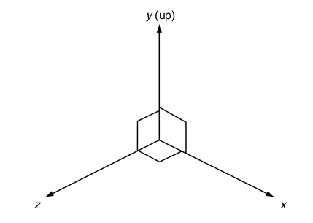
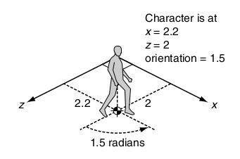
Static Representations
Characters represented as points, centre of mass (collision detection, obstacle avoidance need also size but mostly handled outside of movement algorithms)
In 2D:
x; z orthonormal basis of 2D space
2D movement takes place in x; z
(x; z) coordinates
Orientation value :
counterclockwise angle, in radians
from positive z-axis (as seen from above)
struct Static:
position # a 2D vector
orientation # single floating point value

Slide 4
Dimensions
We can be in 2 or 3 dimensional space
Two is easier than three
Luckily we can mostly get away with 2 ½ Dimensions
Gravity holds us on one plane
Which may vary in y-value
Only need one orientation axis
Assume we are standing up all the time

Slide 5
Basic Movements
Based on:
Current Position
(where we are)
Position of target
(where we want to be)
And possibly
Orientation
(where we are facing)

Slide 6
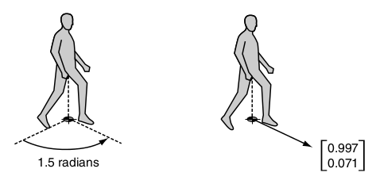
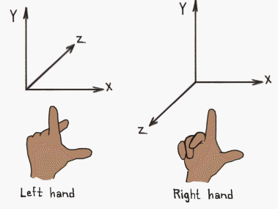
Orientation
Orientation can also be expressed in vector form
Direction
Magnitude
Typically as 2D normalised vector
From angle θ (in Radians) to unit length vector in the direction that the character is facing
If scalar value of orientation is θ then 2D Vector is:
[sin(θ), cos (θ)]
In a left handed system use:
[-sin(θ), cos (θ)]
Notes:
3d Coordinate systems image: http://viz.aset.psu.edu/gho/sem_notes/3d_fundamentals/html/3d_coordinates.html

Slide 7
Basic Movements
We can create movement algorithms based on position and orientation alone. The output will be a target velocity.
But…
Velocity will change instantly making the movement look unrealistic.
And Newton tells us that velocity cannot change instantly!
To make smooth motion we need to either:
- use some kind of smoothing algorithm
- take current velocity and use acceleration to change it
So, we keep track of position and velocity and change the velocity slightly at each time frame smooth motion.

Slide 8
Basic Movements
In General we need to keep track of two types of velocity:
- linear
- angular
Linear represents the speed of the character in each of the axes.
Represented as a vector value
Angular velocity represents how fast the characters’ orientation is changing.
- Angular velocity can be represented by a scalar value. The number of radians per second that the orientation is changing.
- We will call this “Rotation”

Slide 9
Full Entity State
So we need to keep track of:
Position Vector
Where we are
Orientation Scalar
Direction we are facing
Velocity Vector
Direction and speed of movement
Rotation Scalar
Direction and speed of rotation

Slide 10
Movement
Calculated using two values:
(Linear) Acceleration
Change in velocity
Vector
(Angular) Acceleration
Change in rotation
Scalar
The combination of updates gives smooth movement

Slide 11
Updating
Can be done by Physics engine
Or by us using basic physics equation:
D = vt + ½ at²
But lets make life easy …
As time steps are small, t² can be assumed to be zero
Position = Position + Velocity*time
Orientation = Orientation + Rotation*time
Velocity = Velocity + Acceleration*time
Rotation = Rotation + Angular*time

Slide 12
Finally
We now have all the data we need to compute basic movements
These form the basis for everything else
Decide which movement through FSM or RBS or …
Combine movements to get new movement styles

